Slide 1
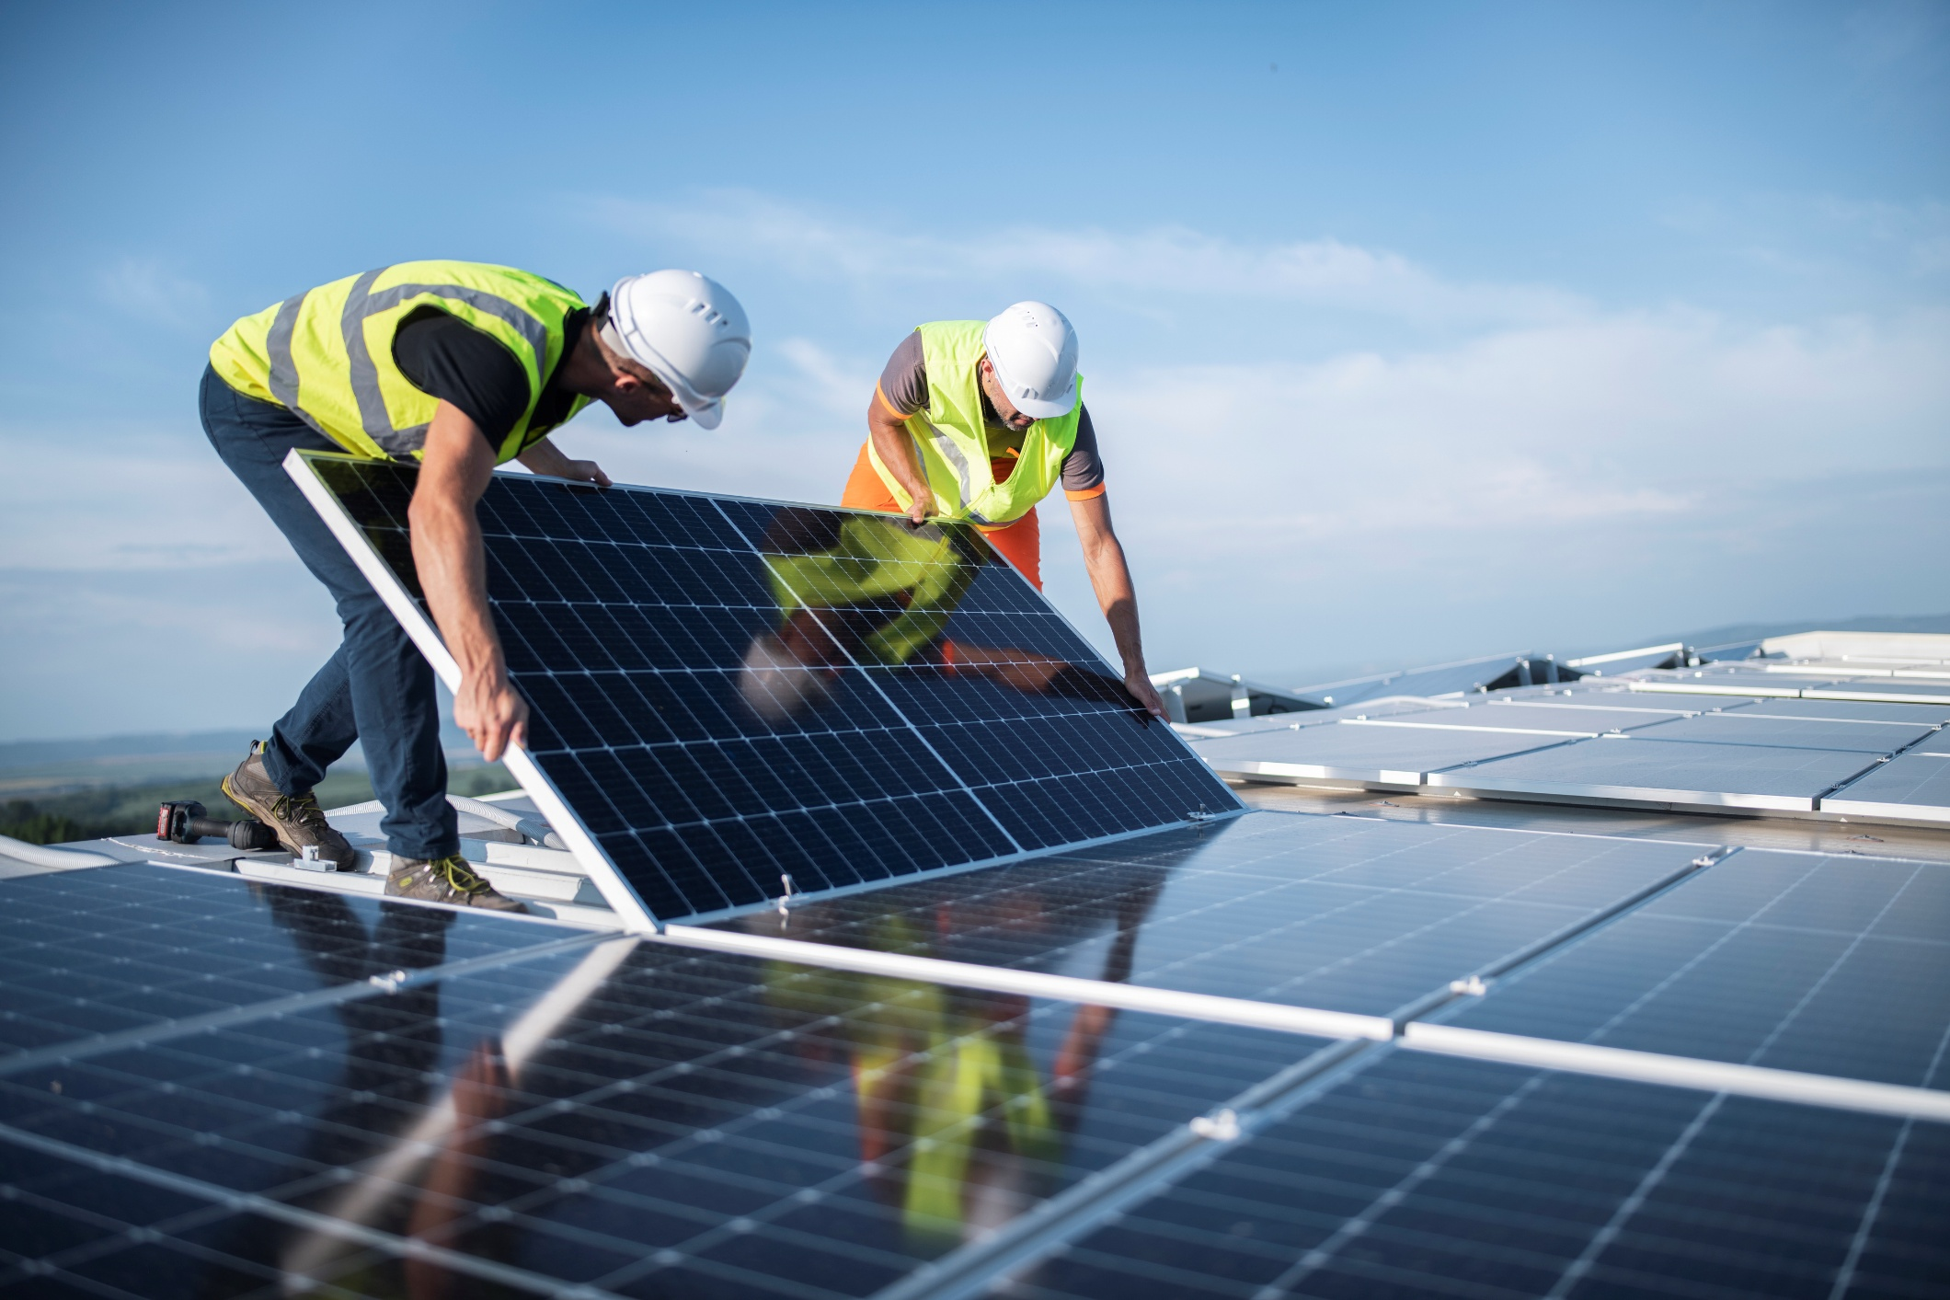

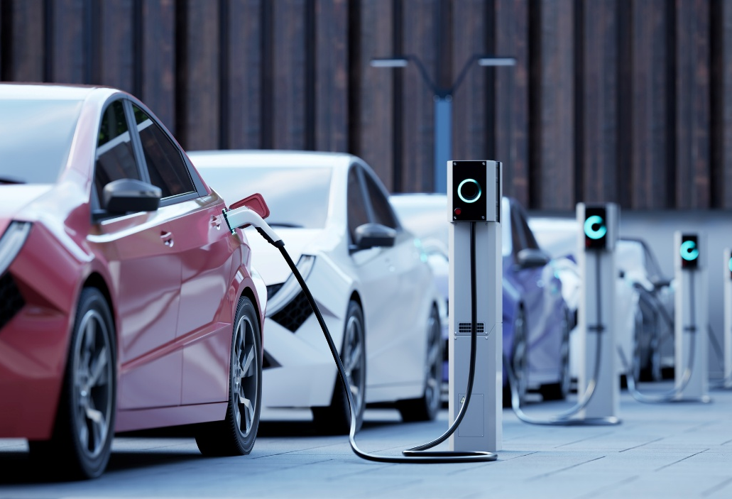

Sustainability Report
2025

Slide 2

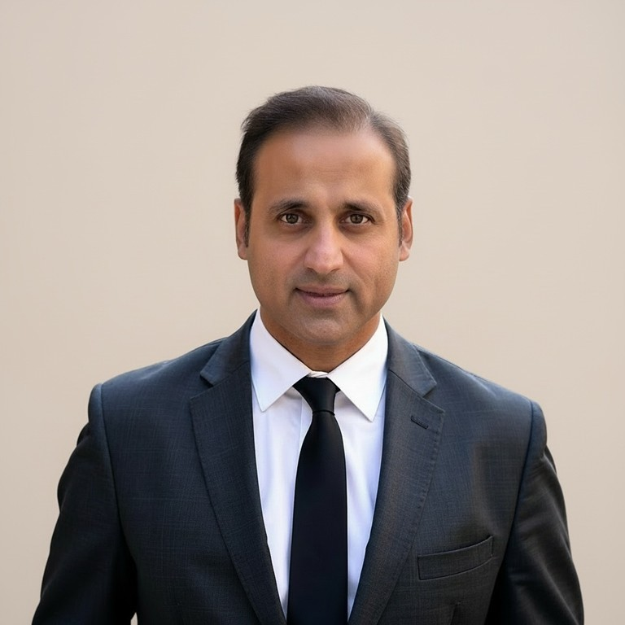

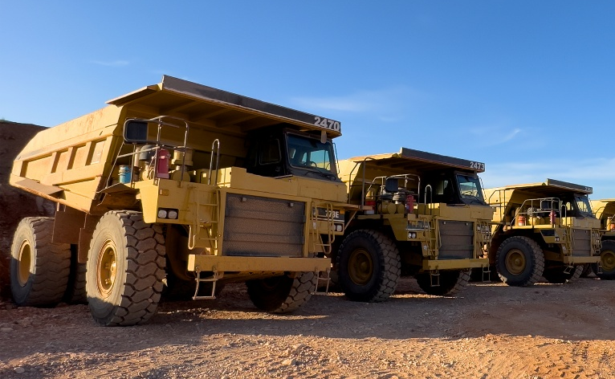

Contents
Message from Our Chief Executive Officer
At CTS, operational excellence and sustainability reinforce each other. Our global teams continue to prove that disciplined execution and responsible operations go hand in hand.
Over the past two years, our most significant environmental achievement has been the systematic transition away from perfluorocarbon-based poling fluids in our piezoelectric manufacturing processes. This initiative—driven by our global engineering and operations teams—has been the primary contributor to a meaningful reduction in our Scope 1 emissions profile, demonstrating how targeted continuous improvement projects can deliver outsized environmental impact.
This progress, combined with steady improvements across safety, water, and waste metrics, reflects the culture of ownership our site teams bring to sustainability every day.
Looking ahead, our continuous improvement programs will remain central to our sustainability progress. By empowering our teams to systematically identify and eliminate waste, improve process efficiency, and optimize resource consumption, we create a virtuous cycle—what's good for operations is good for the environment. We are confident this approach will continue to drive meaningful results across our footprint.
Pratik Trivedi, Chief Executive Officer
INTRODUCTION
Table of Contents
2 Messages from the CEO
COMPANY OVERVIEW
7 Your Partner in Smart Solutions
8 About CTS
PERFORMANCE DATA
10 Disclaimer and Forward-looking Statements
11 Reconciliation to GAAP
12 Reconciliation to GAAP Continued
REPORT FOUNDATION
4 Sustainability Report Foundation
5 Materiality Assessment
13 Performance Data

Slide 3
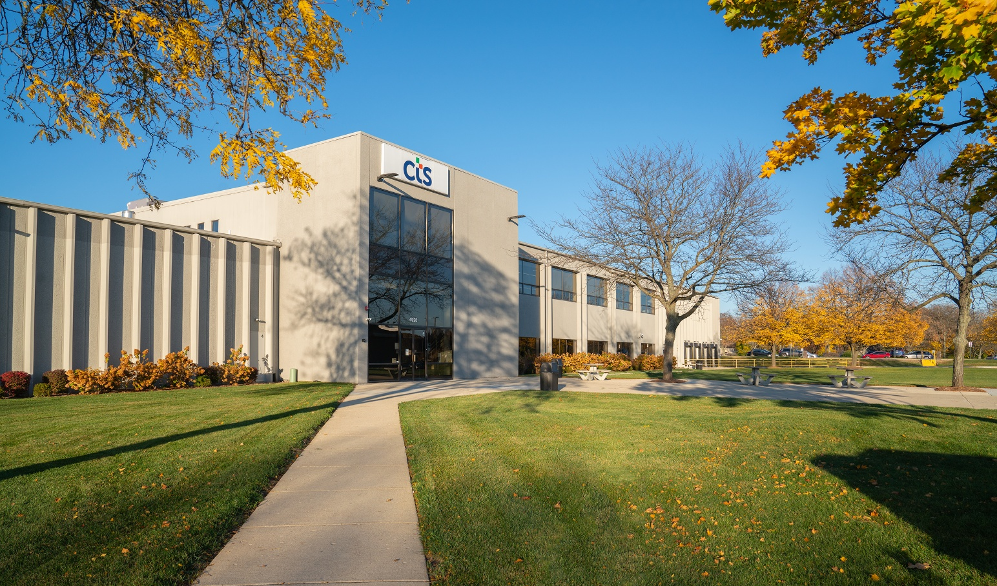

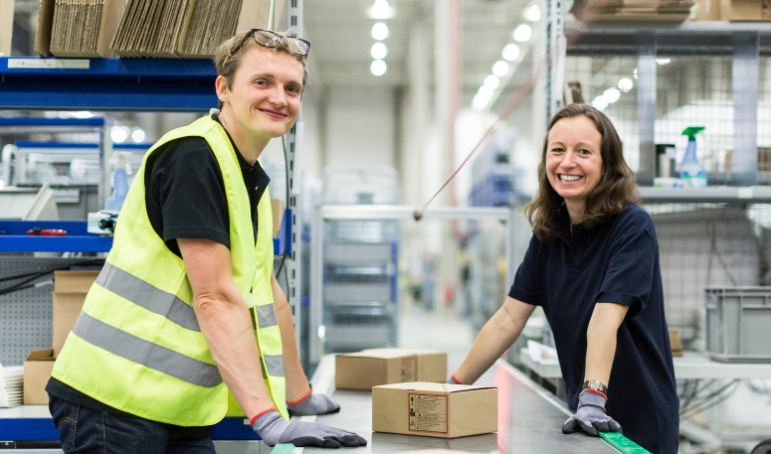
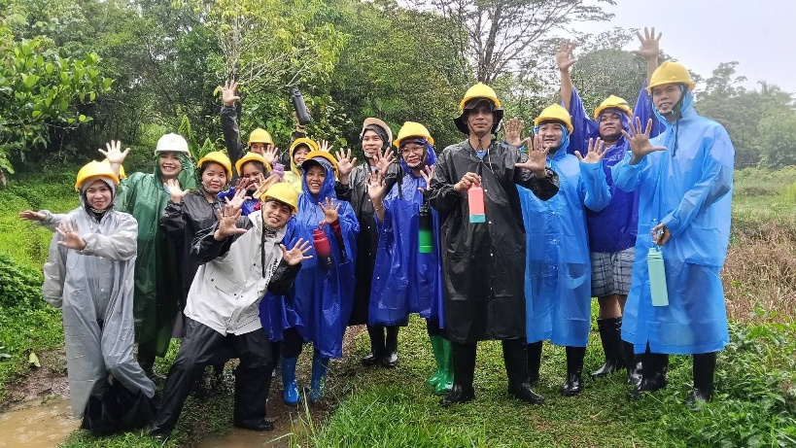

CONTENTS
REPORT FOUNDATION
COMPANY OVERVIEW
PERFORMANCE DATA
CONTENTS INTRODUCTION
REPORT FOUNDATION
COMPANY OVERVIEW SOCIAL ENVIRONMENTAL GOVERNANCE APPENDIX
Report Foundation
CTS CORPORATION 2024 SUSTAINABILITY REPORT 5

Slide 4

REPORT FOUNDATION
CONTENTS
COMPANY OVERVIEW
PERFORMANCE DATA
Sustainability Report Foundation
Governance & Oversight
Our stakeholders and relevant material topics include:
Employees – Workplace safety, diversity, fair wages, and career development.
Executives & Board of Directors – Governance, ESG strategy, and
risk management.
Shareholders & Investors – Sustainable financial performance, ESG disclosures, and risk mitigation.
Customers & End-Users – Product sustainability, ethical sourcing, and societal & environmental impact of the end-product.
Suppliers & Business Partners – Compliance with ESG standards, responsible sourcing, and carbon footprint.
Regulators & Government Agencies – Compliance with environmental laws, labor standards, and anti-corruption policies.
Local Communities – Environmental impact, corporate social responsibility (CSR), and economic development.
The Nominating, Governance and Sustainability Committee of the CTS Board of Directors provides oversight of environmental, social, and governance policies and initiatives.
CTS Sustainability Committee
Our Sustainability Committee is comprised of a cross-functional and diverse team of employees, that includes members representing Environmental, Health & Safety, Human Resources, Legal, Product, Internal Audit, and Supply Chain.
Established in 2021, the Committee leads the effort to assess frameworks, engage stakeholders, identify material topics, and build capabilities to track and report on these areas. These efforts culminated in our inaugural 2022 ESG Report and with a commitment to publish fully ESG reports every two years thereafter. In the odd years, we will publish our current year data to ensure that our sustainability data is available for our stakeholders.
Stakeholder Assessment
Understanding our stakeholders forms the context by which the CTS Sustainability Committee identifies the topics that are most material to CTS Corporation. This Stakeholder Assessment, which was foundational in the 2022 ESG Report, has been re-validated annually and is used to inform the focus of the committee for future action.
Data & Scope
Unless specifically noted, all Sustainability data is as of December 31, of the applicable year (2022, 2023, 2024, 2025.) CTS established our baseline for Sustainability data for the year 2022.
CTS defines organizational boundary under the control method, and it covers all sites that CTS maintains direct control and is represented in our Company Overview section.
CTS obtained independent limited assurance from Trinity Consultants over its 2025 Scope 1 and Scope 2 GHG emissions inventory.

Slide 5

REPORT FOUNDATION
CONTENTS
COMPANY OVERVIEW
PERFORMANCE DATA
Materiality Assessment
Material Topics
People
Environment
Governance
Employees
Board
Investors
Customers
Suppliers
Regulators
Communities
Training and Education/ Career Development | x | x | x
Diversity & Equal Opportunity | x | x | x | x
Community Involvement | x |  |  |  |  |  | x
Health & Safety | x | x | x | x | x | x | x
Water & Wastewater Management | x | x | x | x | x | x | x
Energy Management | x | x | x | x | x | x | x
Waste & Hazardous/ Waste Management | x | x | x | x | x | x | x
Climate Change & GHG Emissions | x | x | x | x | x | x | x
Economic Performance | x | x | x | x | x
Business Ethics | x | x | x | x | x | x | x
Innovation | x | x | x | x | x | x
Sustainable Supply Chain | x | x | x | x | x | x

Slide 6
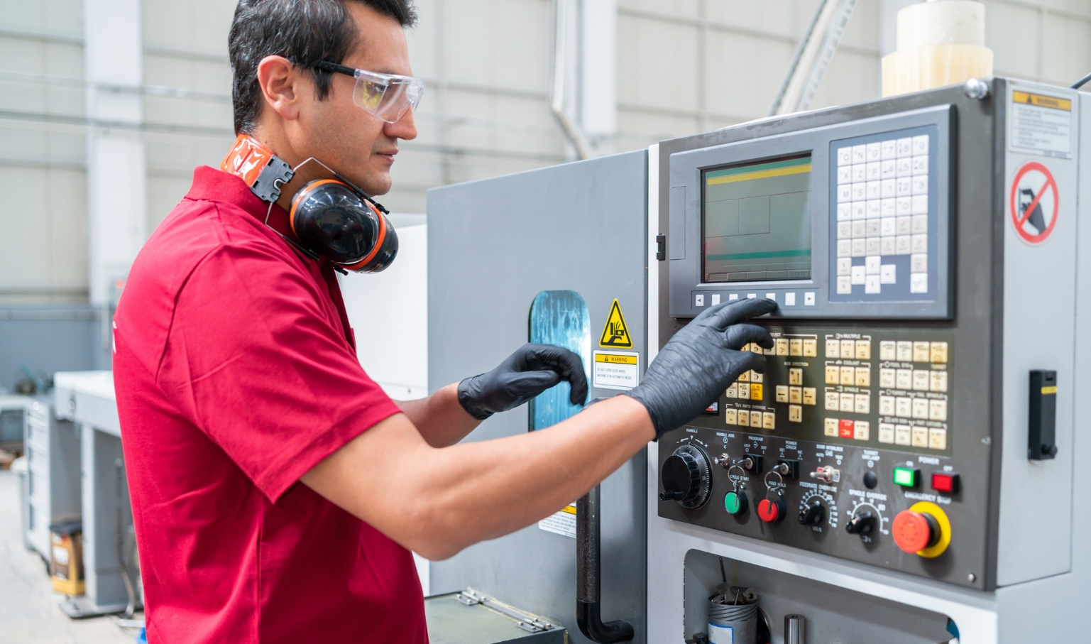

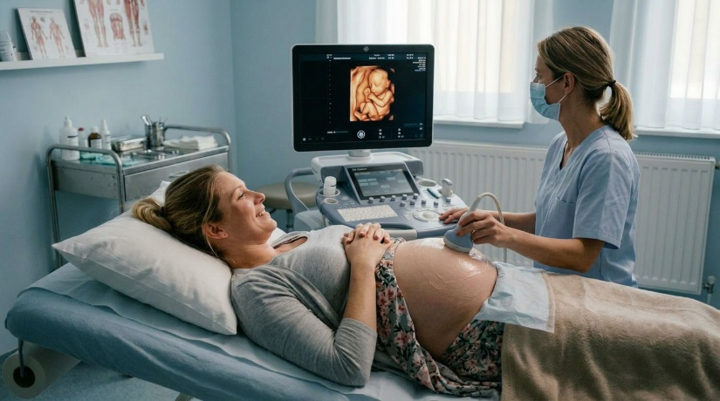
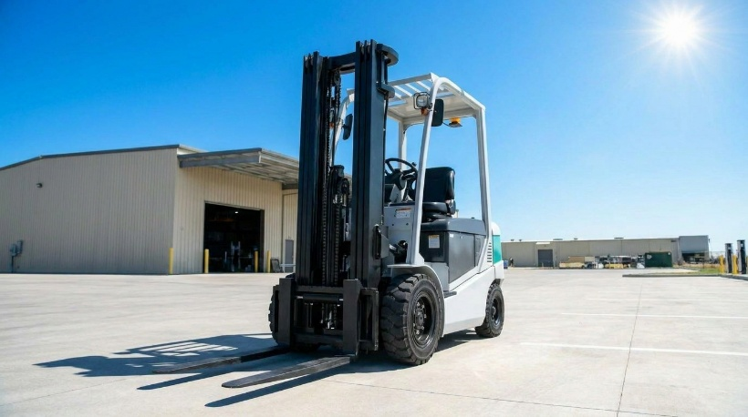

COMPANY OVERVIEW
CONTENTS
REPORT FOUNDATION
PERFORMANCE DATA
CONTENTS
Company Overview
CTS CORPORATION 2024 SUSTAINABILITY REPORT 8

Slide 7

COMPANY OVERVIEW
CONTENTS
REPORT FOUNDATION
PERFORMANCE DATA
CONTENTS
Your Partner in Smart Solutions
At CTS, our mission is to enable an intelligent and seamless world. We strive to fulfill this mission by being instrumental in helping our customers and their
products shape the future. This includes designing highly-engineered solutions with more effective and efficient technologies that make our customers’ products smarter.
2025 By The Numbers*
Revenue (in millions)
$541M
Adjusted EPS²
$2.23
Adjusted EBITDA Margin
22.8%
Number of Locations
20+
Number of Countries
12
Number of Employees (approx.)
3,500
We also understand that we have a responsibility to help shape not only a smarter future, but one that is mindful of the needs of future generations. Making responsible business choices creates long-term value for the company, our stakeholders, and the
communities in which we live and do business.
The goal of our 2025 condensed report is to provide our stakeholders with more timely and relevant sustainability performance data. This report is designed to be used in conjunction with our full 2024 Sustainability Report to get a complete picture of the types of initiatives underway at CTS to further our sustainability objectives.
*A reconciliation of each non-GAAP financial measure to its most directly comparable GAAP financial measure is included in the Appendix to this Report.

Slide 8
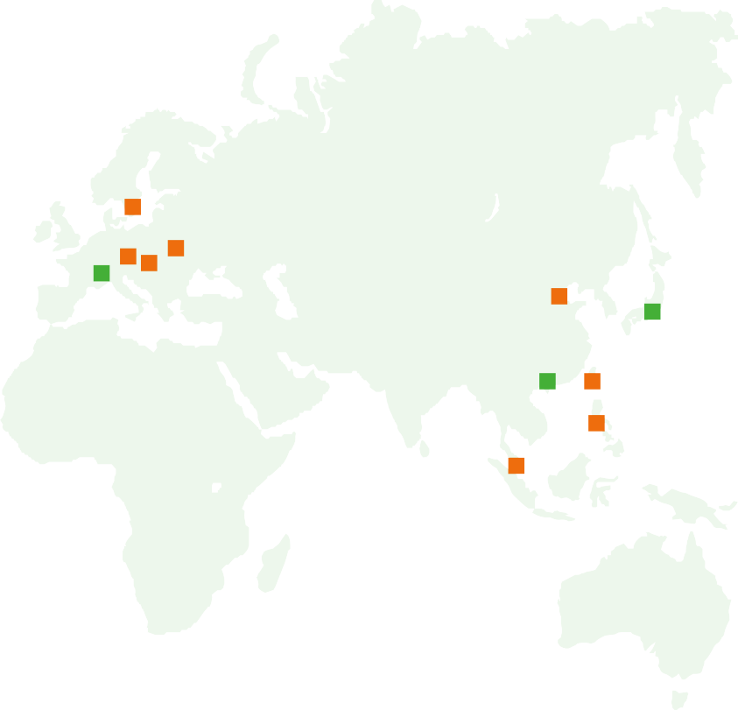

COMPANY OVERVIEW
CONTENTS
REPORT FOUNDATION
PERFORMANCE DATA
CONTENTS
About CTS
Global Design and Manufacturing Capabilities
Applying deep technical expertise across our diverse end markets provides a sustainable advantage.
Industrial
26%
Medical
16%
Aero & Defense
15%
Transportation
43%
10%
Diversified End Market Revenue CAGR
CTS has always aimed to be at the forefront of technology, delivering innovative sensing, connectivity, and motion solutions enabling an intelligent and seamless world.
Europe
18%*
Asia
22%*
North America
60%*
Sales/Technical Office Manufacturing Facility
*Percentages reflect the revenue generated by CTS from the applicable geography as of December 31, 20265

Slide 9



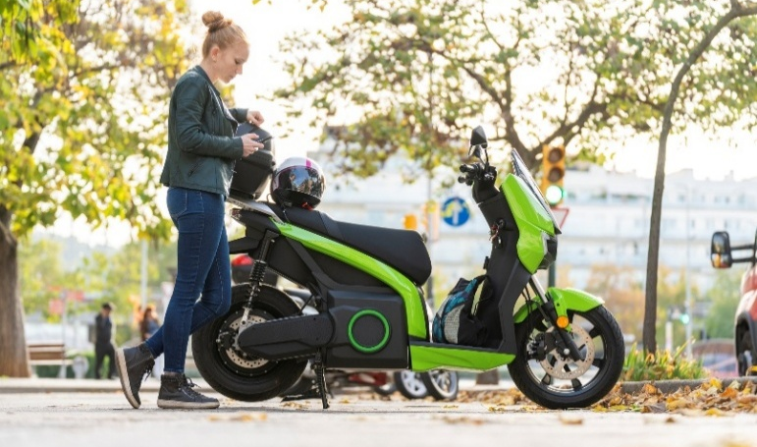

PERFORMANCE DATA
CONTENTS
REPORT FOUNDATION
CONTENTS
COMPANY OVERVIEW
Performance Data
CTS CORPORATION 2024 SUSTAINABILITY REPORT 8

Slide 10
PERFORMANCE DATA
CONTENTS
REPORT FOUNDATION
CONTENTS
COMPANY OVERVIEW
Disclaimer/Forward-Looking Statements
Readers are cautioned that certain statements made by CTS Corporation (“CTS”) relating to environmental, social and governance (“ESG”) matters, including those included in this ESG Report or on its website (such statements, “ESG Statements”), may constitute “forward-looking statements” as defined by the “safe harbor” provisions in the Private Securities Litigation Reform Act of 1995. Such statements are made in reliance on the safe harbor provisions of Section 27A of the Securities Act of 1933 and Section 21E of the Securities Exchange Act of 1934. All statements, other than statements of historical fact, included or incorporated in this document, including statements regarding our strategy, financial position, guidance, funding for continued operations, cash reserves, liquidity, projected costs, plans, projects, awards and contracts, and objectives of management, among others, are forward-looking statements. Words such as “expect,” “anticipate,” “should,” “believe,” “hope,” “target,” “continued,” “project,” “plan,” “goals,” “opportunity,” “appeal,” “estimate,” “potential,” “predict,” “demonstrates,” “may,” “will,” “might,” “could,” “intend,” “shall,” “possible,” “would,” “approximately,” “likely,” “outlook,” “schedule,” “on track,” “poised,” “pipeline,” and variations of these terms or the negative of these terms and similar expressions are intended to identify these forward-looking statements, but the absence of these words does not mean that a statement is not forward-looking. These forward-looking statements are not guarantees of future performance, conditions or results. Forward-looking statements are based on management’s expectations, certain assumptions, and currently available information. Readers are cautioned not to place undue reliance on these forward-looking statements, which speak only
as of the date hereof and are based on various assumptions as to future events, the occurrence of which necessarily are subject to uncertainties. These forward-looking statements are made subject to certain risks, uncertainties, and other factors, which could cause CTS’ actual results, performance, or achievements to differ materially from those presented in the forward-looking statements. Examples of factors that may affect future operating results and financial condition include, but are not limited to: supply chain disruptions (including, but not limited to, the availability and cost of rare earth elements, minerals and metals); changes in the economy generally, including inflationary and/or recessionary conditions and increased tariffs, and in respect to the businesses in which CTS operates; unanticipated issues in integrating acquisitions; the funding of contracts by the U.S. Government; the results of actions to reposition CTS’ business; rapid technological change; general market conditions in the transportation, as well as conditions in the industrial, aerospace and defense, and medical markets; reliance on key customers; unanticipated public health crises, natural disasters or other events; environmental compliance and remediation expenses; the ability to protect CTS’ intellectual property; pricing pressures and demand for CTS’ products; risks associated with CTS’ international operations, including trade and tariff barriers, trade pacts, including the future of the USMCA, exchange rates and political and geopolitical risks (including, without limitation, the impact of tariffs on China, Canada and Mexico, and other nations); the potential impact of U.S./China relations and the impact of geopolitical conflicts may have on our business, results of operations
and financial condition; write offs of goodwill on our balance sheet; the amount and timing of any share repurchases; and the effect of any cybersecurity incidents on our business. Many of these, and other risks and uncertainties, are discussed in further detail in Item 1A. of CTS’s most recent Annual Report on Form 10-K and other filings made with the SEC. CTS undertakes no obligation to publicly update CTS’ forward-looking statements to reflect new information or events or circumstances that arise after the date hereof, including market or industry changes. The ESG-related information presented, discussed, referenced or otherwise included in this ESG Report or made available on or through our website does not cover all information about our business. The inclusion or absence of information in CTS’ ESG Statements should not be construed to represent any belief regarding the materiality of such information to our financial results or that such information is necessarily material to investors or other stakeholders for purposes of U.S. federal securities laws. The ESG-related goals and targets presented, discussed, referenced or otherwise included in this ESG Report or made available on or through our website are aspirational and not guarantees or promises that such goals or targets will be achieved. ESG Statements may be based on standards and practices for measuring progress that are still developing, internal controls and processes that continue to evolve, and expectations and assumptions that are necessarily uncertain and may be prone to error or subject to misinterpretation given the long timelines involved and the lack of an established single approach to identifying, measuring and reporting on many ESG matters.
Where You Can Find More Information
Annual, quarterly and other reports filed with the Securities and Exchange Commission by CTS, contain important additional information about CTS and readers are urged to read CTS’ ESG Statements together
with those filings, copies of which are available, as applicable, on CTS’ website at investors.ctscorp.com.

Slide 11
PERFORMANCE DATA
CONTENTS
REPORT FOUNDATION
CONTENTS
COMPANY OVERVIEW
Reconciliation of Net Earnings (Loss) to Adjusted EBITDA
($ in millions)
 | 2022 (FULL YEAR) | 2023 (FULL YEAR) | 2024 (FULL YEAR) | 2025 (FULL YEAR)
Net earnings (loss) | $59.6 | $60.5 | $55.5 | $65.3
Net sales | $586.9 | $550.4 | $514.8 | $541.3
Net earnings (loss) margin | 10.2% | 11.0% | 10.8% | 12.1%
Depreciation and amortization expense | 29.8 | 28.7 | 30.9 | 34.5
Interest expense | 2.2 | 3.3 | 4.2 | 4.3
Tax expense (benefit) | 21.2 | 14.6 | 13.1 | 18.5
EBITDA | 112.7 | 107.2 | 103.7 | 122.6
Adjustments to EBITDA:
Restructuring charges (c) | 1.9 | 7.1 | 4.7 | 1.4
Restructuring related charges (b) | — | 0.6 | 0.7 | 0.7
Environmental charges (a) | 2.8 | 3.5 | 1.6 | 5.5
Acquisition-related costs (a) | 2.5 | 0.4 | (0.3) | (5.6)
Inventory fair value step-up (b) | 4.0 | — | 2.1 | —
Non-cash pension and related expense (d) | 4.8 | — | 0.2 | 0.1
Foreign currency (gain) loss (d) | 4.9 | 2.0 | 2.7 | (1.3)
Total adjustments to EBITDA | 20.9 | 13.5 | 11.7 | 0.9
Adjusted EBITDA | $133.6 | $120.7 | $115.4 | $123.4
Adjusted EBITDA Margin | 22.8% | 21.9% | 22.4% | 22.8%

Slide 12
PERFORMANCE DATA
CONTENTS
REPORT FOUNDATION
COMPANY OVERVIEW
Reconciliation of Diluted Earnings (Loss) Per Share to Adjusted Diluted Earnings Per Share
($ in millions)
 | 2022 (FULL YEAR) | 2023 (FULL YEAR) | 2024 (FULL YEAR) | 2025 (FULL YEAR)
Diluted earnings (loss) per share | $1.85 | $1.92 | $1.80 | $2.19
Tax affected adjustments to reported diluted earnings (loss) per share:
Restructuring charges | 0.06 | 0.22 | 0.12 | 0.04
Restructuring related charges | — | — | 0.02 | 0.02
Environmental charges | 0.09 | 0.11 | 0.04 | 0.14
Acquisition-related costs | 0.08 | 0.01 | (0.02) | (0.15)
Inventory fair value step-up | — | — | 0.05 | —
Non-cash pension expense | 0.15 | — | 0.01 | —
Foreign currency loss | 0.15 | 0.06 | 0.09 | (0.04)
Other discrete tax items | 0.01 | (0.05) | 0.01 | 0.03
Adjusted diluted earnings per share | $2.46 | $2.22 | $2.12 | $2.23

Slide 13
PERFORMANCE DATA
CONTENTS
REPORT FOUNDATION
COMPANY OVERVIEW
Performance Data
METRIC | 2022¹⁸ | 2023 | 2024 | 2025
General
Revenue (Million USD) | 587 | 550.4 | 514.8 | 541.3
Operational Sites¹ | 16 | 15 | 15 | 15
Total CTS Employees¹⁶ | 4,210 | 4,082 | 3,544 | 3,492
CTS Employees Total Hours Worked² | 8,986,773 | 8,629,397 | 8,180,756 | 7,916,839
Governance: Business Ethics
Description of policies and practices for prevention of: (1) corruption and bribery and (2) anti-competitive behavior^{3,16} | See Note 13 | See Note 13 | See Note 13 | See Note 13
% of Sites Covered by CTS Ethics & Compliance Hotline (Percentage) | 100% | 100% | 100% | 100%
# of Ethics Hotline Reports / Year | 16 | 10 | 11 | 19
Total amount of monetary losses as a result of legal proceedings associated with bribery or corruption¹⁶ (USD) | $- | $- | $- | $-
Total amount of monetary losses as a result of legal proceedings associated with anticompetitive behavior regulations¹⁶ (USD) | $- | $- | $- | $-
Governance: Board Information
Board of Directors | 7 | 7 | 7 | 8
Independent Board Members | 6 | 6 | 6 | 7
Female Directors | 2 | 2 | 2 | 3
Non-Female Minority Directors | 1 | 1 | 1 | 1
% of minority representation on board of directors | 43% | 43% | 43% | 50%

Slide 14
PERFORMANCE DATA
CONTENTS
REPORT FOUNDATION
COMPANY OVERVIEW
Performance Data
METRIC | 2022¹⁸ | 2023 | 2024 | 2025
Social: Health and Safety⁴
Total Recordable Incident Rate (TRIR) (Number per 100 Employees) | 0.73 | 0.49 | 0.44 | 0.43
Lost Time Incident Rate (Number per 100 Employees) | 0.38 | 0.21 | 0.24 | 0.20
Fatality Rate (Number per 100 Employees) | 0 | 0 | 0 | 0
Near Miss Frequency Rate (NMFR) (Number per 100 Employees) | 11.39 | 3.94 | 2.18 | 1.84
Social: Employees and Diversity⁵
Employees in Asia | 1,353 | 1,262 | 1,166 | 1,102
Employees in Europe | 564 | 525 | 509 | 520
Employees in North America | 2,293 | 2,295 | 1,869 | 1,870
Total CTS Employees | 4,210 | 4,082 | 3,544 | 3,492
% of female employees worldwide | 52.% | 57% | 57% | 56%
% of female in leadership or management roles⁶ | 26% | 28% | 30% | 30%
Social: Corporate Sponsored Training and Community Engagement⁷
Community Service Hours | 4,414 | 5,538 | 7,858 | 7,506
HR & Leadership Training Hours | 3,571 | 9,415 | 5,257 | 536
Ethics & Compliance Training Hours | 2,332 | 2,020 | 3,932 | 2,601
Safety Training Hours | 4,436 | 4,262 | 3,377 | 3,004

Slide 15
PERFORMANCE DATA
CONTENTS
REPORT FOUNDATION
COMPANY OVERVIEW
Performance Data
METRIC | 2022¹⁸ | 2023 | 2024 | 2025
Cybersecurity Awareness Training Hours | 2,052 | 855 | 855 | 956
Total Training Hours | 12,391 | 16,552 | 13,421 | 7,097
Training Hours per Employee | 2.9 | 4.0 | 3.8 | 2.0
Environmental: Greenhouse Gas Emissions^{1,8}
Scope 1 (Metric Tons CO2e) | 150,125 | 89,077 | 55,294 | 16, 137
Scope 2: Location Based (Metric Tons CO2e)17 | 32,185 | 30,425 | 28,895 | 38,799
Scope 2: Market Based (Metric Tons CO2e)17 | 29,353 | 28,645 | 28,232 | 35,061
GHG Total (Scope 1 & 2): Location Based (Metric Tons CO2e) | 182,310 | 119,503 | 84,189 | 54,936
GHG Total (Scope 1 & 2): Market Based (Metric Tons CO2e) | 179,478 | 117,772 | 83,526 | 51,198
GHG Emission Intensity: Location Based (Metric Tons CO2e / Revenue) | 310 | 217.1 | 163.5 | 101.5
GHG Emission Intensity: Market Based (Metric Tons CO2e / Revenue) | 305 | 214.0 | 162.5 | 94.6
Environmental: Energy Management
Non-Renewable Sources (MWh) | 64,794 | 62,659 | 60,932 | 59,628
Renewable Sources (MWh) | 39 | 56 | 29 | 73
Total Energy Consumed (MWh) | 64,833 | 62,715 | 60,961 | 59,701
Energy Intensity (MWh/$M Revenue) | 110.5 | 113.94 | 118.1 | 110.3
Total Energy Consumed¹⁶ (Gigajoules (GJ)) | 233,258 | 225,774 | 219,462 | 214,923

Slide 16
PERFORMANCE DATA
CONTENTS
REPORT FOUNDATION
COMPANY OVERVIEW
Performance Data
METRIC | 2022¹⁸ | 2023 | 2024 | 2025
% Grid Electricity¹⁶ | 1.00 | 1.00 | 1.00 | 1.00
% Renewable Energy¹⁶ | 0.00% | 0.10% | 0.05% | 0.12%
Environmental: Water¹
Water Withdrawn (Megaliters) | 346 | 344 | 277 | 260
Water Withdrawn from High Water Stress⁹ (Megaliters) | N/A | N/A | 101 | 200
Water Intensity (Megaliters/$M Revenue) | 0.58 | 0.62 | 0.53 | 0.48
Environmental: Hazardous Waste¹
Amount of Hazardous Waste Generated (Metric Tons)^{10,16} | 758 | 724 | 606 | 935
Percentage Hazardous Waste Recycled^{10,16} | 29.0% | 46.1% | 30.8% | 60.4%
Number of Reportable Spills¹⁶ | — | — | — | —
Aggregate Quantity of Reportable Spills and Quantity Recovered (Kilograms (KG))^{11,16} | — | — | — | —
Sustainable Supply Chain: Supply Chain Ethics
Description of the management of risks associated with the use of critical materials^{12,16} | See Note 12 | See Note 12 | See Note 12 | See Note 12
# of conflict mineral issues in supply chain reported | — | — | — | —
# of human trafficking issues in supply chain reported | — | — | — | —

Slide 17
PERFORMANCE DATA
CONTENTS
REPORT FOUNDATION
COMPANY OVERVIEW
Performance Data
METRIC | 2022¹⁸ | 2023 | 2024 | 2025
Sustainable Supply Chain: Product Lifecycle Management
Number of Recalls¹⁶ | — | — | — | —
Total Units Recalled¹⁶ | — | — | — | —
Total amount of money losses as a result of legal proceeding associated with product safety.¹⁶ (USD) | — | — | — | —
Percentage of products by revenue that contain IEC 62474 declarable substances.^{13,16} (% by Revenue) | — | — | — | —
Percentage of eligible products, by revenue, that meet ENERGY STAR™ criteria.^{14,16} (% by Revenue) | — | — | — | —
Revenue from receivable energy-related and energy-efficient related products.^{15,16} (USD) | — | — | — | —

Slide 18
PERFORMANCE DATA
CONTENTS
REPORT FOUNDATION
COMPANY OVERVIEW
Performance Data
Notes
Data measured from manufacturing operations at CTS’ facilities located in the United States (Albuquerque, NM; Boise, ID; Cranston, Rhode Island; and Lisle, IL), outside the United States (Kaohsiung, TW; Kvistgaard, DK; Lublin, PL; Matamoros, MX; Nogales, MX; Ostrava, CZ; Calamba, PH; Prague, CZ; Tecate, MX; Tianjian, CN; and Zhongshan, CN) and our engineering headquarters in Elkhart, IN. For locations acquired or closed by CTS during a reporting year the partial year data is included and excluded based on period of control under CTS, as applicable.
Total hours worked were calculated based on actual hours worked by hourly employees and the expected 1,920 hours per year for salaried employees.
These topics are covered by Ethical Standards 4 and 6 of the CTS Code of Ethics. A copy of CTS’ Code of Ethics can be found in the governance section of its website at investors.ctscorp.com. In addition, CTS provides its employees with annual training regarding the Code of Ethics and other compliance-related topics.
Health and safety data measured based on all CTS full-time and temporary employees. BLS Industry Data can be found here: https://www.bls.gov/charts/injuries-and-illnesses/total-nonfatal-work-injuries-and-illnesses-by-year.htm
Employee data is measured from all CTS locations including operational sites, sales offices, and remote employees.
For purposes of this metric, a leadership or management role is defined as any role that has at least 1 direct report based on CTS’ internal employee organization and reporting system.
Where actual training times were not available, training hours were estimated based on the number of participants and expected time to complete course, as applicable
The GHG calculations are based upon the The Greenhouse Gas Protocol: A Corporate Accounting and Reporting Standard.
Water Stress determined using the Water Resources Institute (WRI) Aqueduct Water Risk Atlas.
Hazardous wastes are defined per the applicable legal or regulatory frameworks (i.e., U.S. Resources Conservation and Recovery Act (RCRA) or the EU Waste Framework Directive (Directive 2008/98/EC on waste, including its subsequent amendments) within the jurisdictions in which CTS operates.
The Company is engaged in remediation activities at legacy operating locations under the supervision of state and federal environmental authorities that may or may not be the result of spills at those locations that occurred prior to the reporting period. These activities include investigation of the nature and extent of contamination, remedial action to address the hazards posed by site contamination and on-going site maintenance and monitoring, in each case in accordance with applicable legal, contractual and regulatory requirements.
CTS uses critical materials in some of its products but at a level that is not material in light of CTS’ overall supply chain spend and product portfolio. A discussion of CTS’ policies and practices for the management of risks associated with the use of conflict minerals can be found in CTS’ Form SD filed with the SEC each May in accordance with SEC requirements on the EDGAR platform.
Some of CTS’ products contain IEC declarable substances; however, CTS is in the process of analyzing the relevant data and developing an approach to capturing and measuring the data.
The majority of CTS’ products are components used within other items or products for a specific end use and do not consume energy. As a result, ENERGY STAR™ criteria are not applicable to CTS’ products.
The majority of CTS’ products are components used within other items or products for a specific end use and do not consume energy. As a result, CTS’ products do not themselves generate revenue from energy-efficient or energy related products. While some of CTS’ products may be used in other products that may be energy efficient or energy related, CTS does not have access to that information. As result, CTS has not included a value for this metric.
CTS is aligned to the SASB standard specific to our primary industry as identified in the Sustainable Industry Classification System® (SICS®): Resource Transformation Sector—Electrical & Electronic Equipment Sustainability Accounting Standard (October 2018). Any omitted topics or data from the standard have been determined to not be material based on our current business model, business strategy and relevant legal requirements per SASB application guidance. Unless otherwise indicated, all accounting metrics have been calculated in accordance with the SASB standard and guidelines.
Includes GHG emissions related to steam/heat, which CTS was first able to determine in 2025.
Unless otherwise noted, all sustainability data is baselined for the reporting period 2022.

Slide 19

CTS Corporation Headquarters • 4925 Indiana Avenue • Lisle, Illinois 60532 • ctscorp.com

